Slide 1

BBA 3rd SEM Session (2023-24) Google Reviews
Submitted to:
Pankaj Tiwari
Submitted By:
Shankh Bansal

Slide 2

Introduction
Reviews on a Google Business Profile hold immense importance for businesses. They act as a window into your business for potential customers and have a significant impact on your online reputation. Here's why reviews matter:

Slide 3
Customer Trust
Trust and Credibility: Positive reviews build trust and credibility. When people see that others have had a good experience with your business, they are more likely to trust your services or products.
Customer Insights: Reviews provide valuable insights into what customers like or dislike about your business. This feedback can help you make informed decisions to improve your offerings and customer service.
Local SEO and Visibility: Google values reviews in its search algorithm. The more positive reviews you have, the higher your business is likely to appear in local search results. This improves your visibility and attracts more potential customers.

Slide 4
Feedback for Improvement
Consumer Influence: Many consumers read reviews before making a purchase decision. Positive reviews can influence their choice and drive them to choose your business over competitors.
Engagement and Interaction: Responding to reviews, especially negative ones, shows that you value your customers' feedback and are committed to addressing concerns. This engagement portrays a positive image of your business.
Free Marketing: Positive reviews act as free marketing. Satisfied customers essentially promote your business to others, expanding your customer base at no cost.
Competitive Advantage: A higher rating and more positive reviews can give you a competitive edge in your industry. Customers often compare ratings before deciding where to spend their money.

Slide 5
SEO and Visibility
Customer Retention: When you respond to reviews, especially negative ones, and show genuine concern for customers' experiences, you can turn dissatisfied customers into loyal ones.
Improves Products and Services: Honest feedback from customers helps you identify areas for improvement, enabling you to refine your products or services to better meet customer needs and expectations.
Builds Relationships: Engaging with customers through reviews builds a sense of community and rapport. It shows that you value their opinions and are committed to delivering the best possible experience.

Slide 6
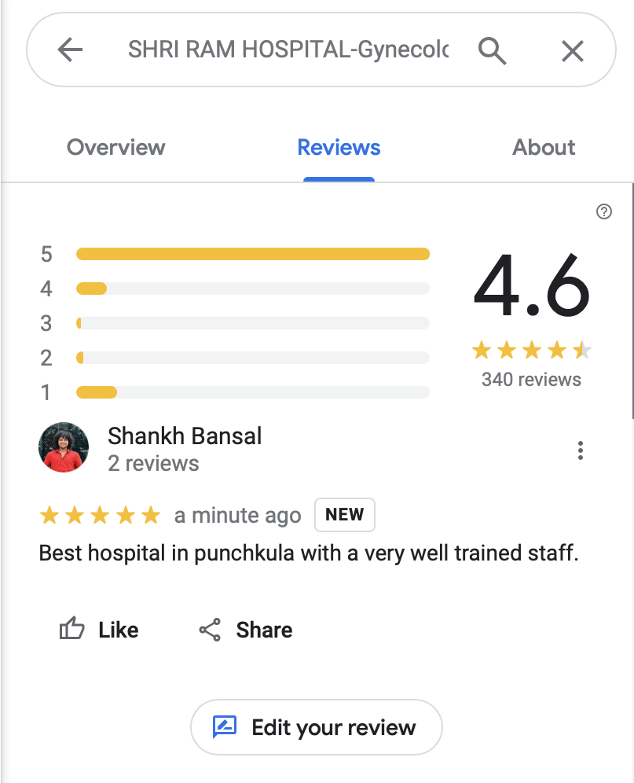
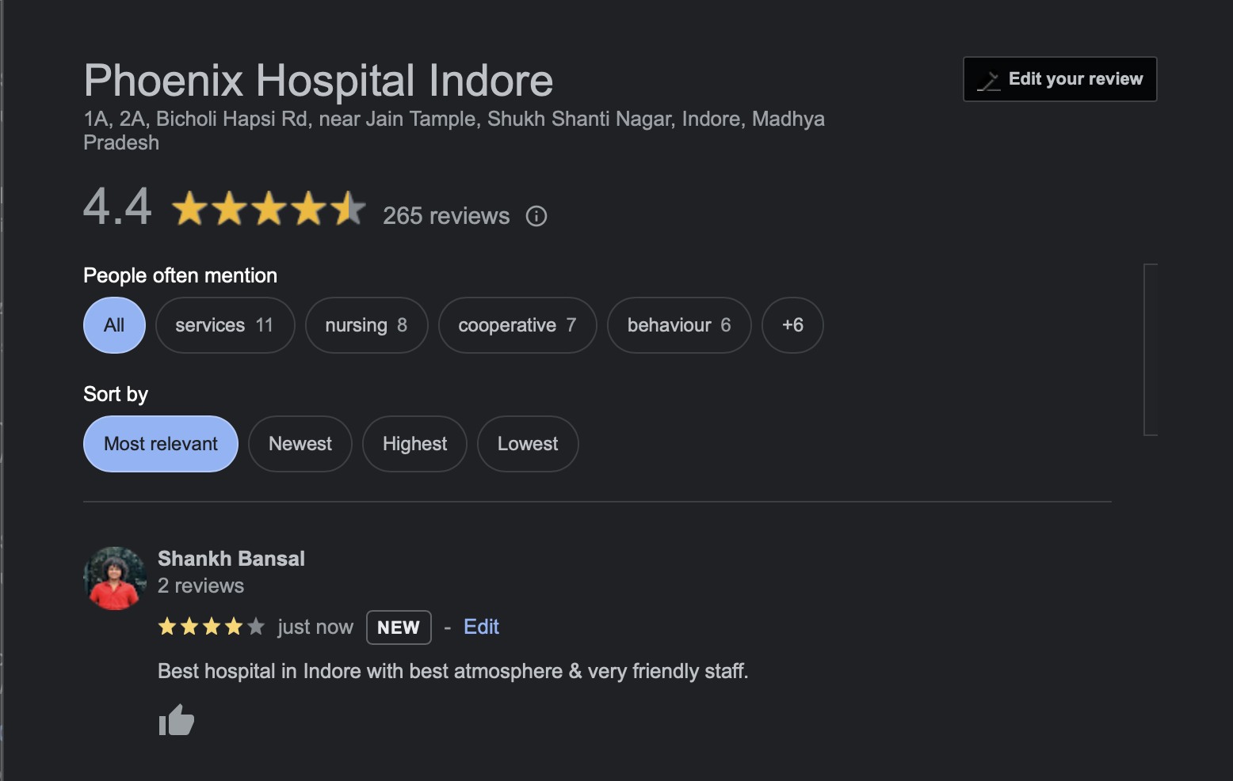
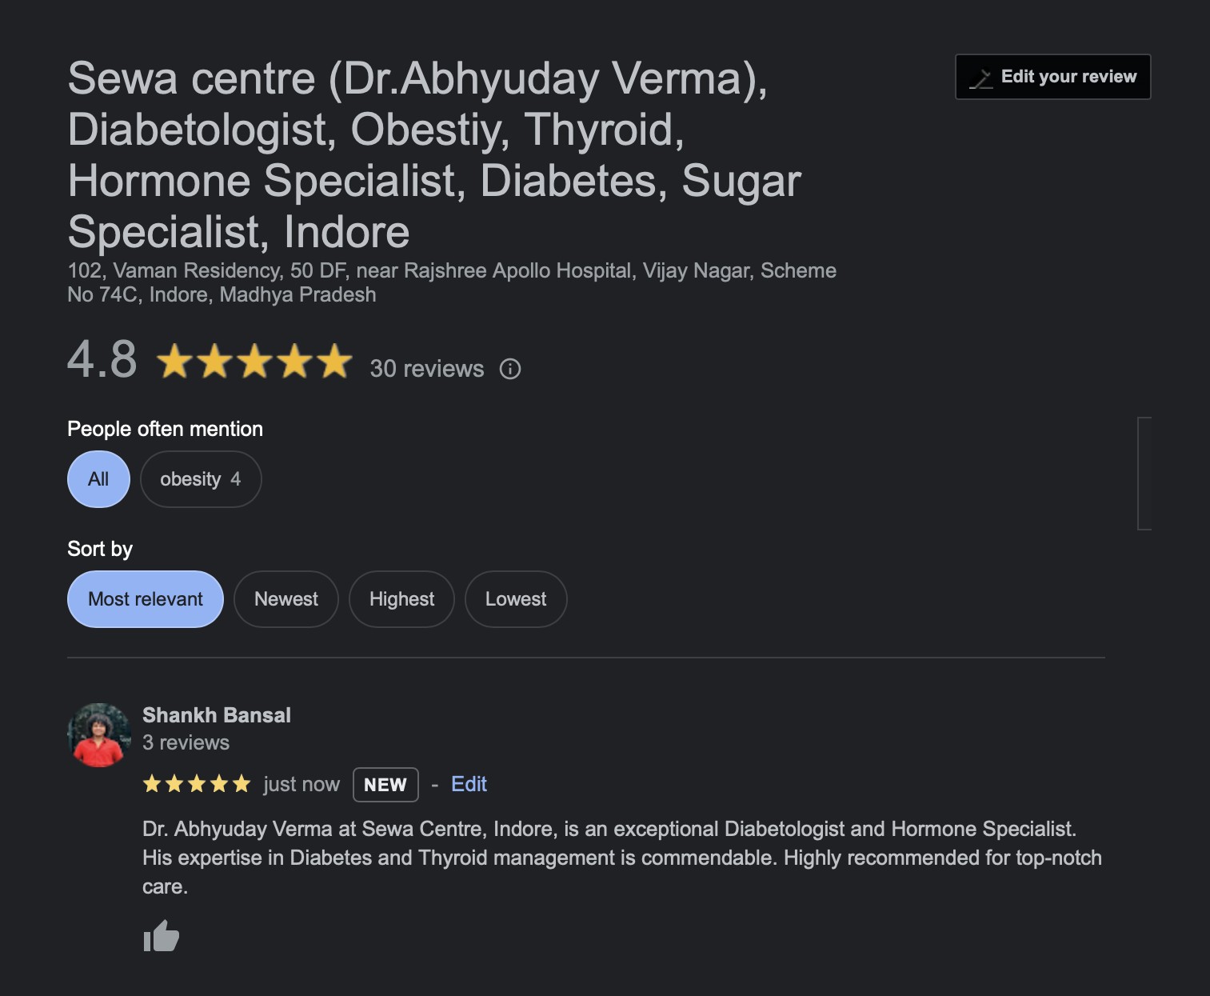

Reviews

Slide 7

Conclusion
Encourage satisfied customers to leave reviews and promptly respond to all reviews, addressing concerns and expressing gratitude. Treat reviews as an ongoing conversation with your audience, and leverage their feedback to grow and enhance your business.

